Slide 1
3 Replicates of data for A. baumannii infection with CSF treatment
To go in CSF paper
Graph and cox-hazard ratio included
4-22-2020

Slide 2
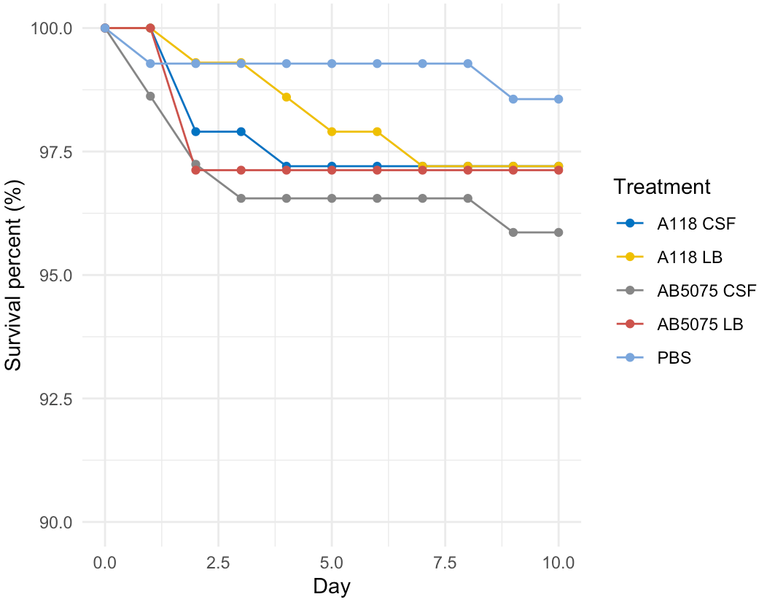
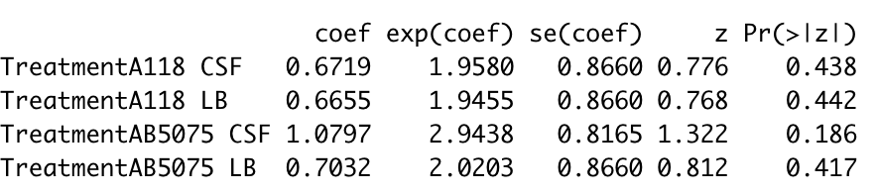
Bacteria: A118, AB5075 combined
Conditions: PBS (baseline), LB, CSF
Hazard ratios

Slide 3
To test the influence of CSF in A. baumanii pathogenesis, a Drosophila melanogaster infection model was used. Inoculation with A118 or AB5075 grown in LB did not affect survival of flies relative to controls (p=0.442, p=0.417). A118 growth in CSF did not affect survival relative to controls (p=0.186). However, for Ab5075 when the bacterial cells were cultured in the presence of CSF, the survival was reduced to 94% of inoculated individuals for (Figure 2C, P-value=0.186). It is noteworthy that the D. melanogaster population used in this study is outbred and has been shown to be more robust than inbred fly lines used in many laboratories (Reference number). Thus, even in highly robust D. melanogaster populations, there is an observable increase in virulence of A. baumannii when exposed to CSF. These results showed that the presence of CSF increases the virulence of A. baumannii. Furthermore, this is, to our best knowledge, the first utilization of D. melanogaster as model of infection of A. baumannii. We are presently performing comparative infection assays using other well-established models to further validate D. melanogaster as a viable and convenient model.

